Slide 1
Spacecraft-Control-Center Training and Testing Environment (STaTE)
Juliana Altamira, Carly Bosma, Jeff Cevallos, Kyle Garber, Jeremy Mog, Jesse Slager, Annamaria Summer

Slide 2
Table of contents
Product Vision
Product Breakdown
01
02
Challenges & constraints
Conclusion
03
04
Overview &
Target Student Outcomes
Requirements,
Mission Objective, &
Architecture
Problems & Solutions
Project Summary

Slide 3
01
Product vision

Slide 4
Product Vision
“STaTE will serve as a simulated learning platform for use in testing and training of students in the Space Flight Operations degree program.”
Target Student Outcomes:
Understand more about spacecraft control consoles
Improve troubleshooting skills by properly addressing these situations in real-time
Gain broader experience by performing several different roles and responsibilities
Work as a team of students to resolve anomalies and complete an assigned mission

Slide 5
02
Product Breakdown

Slide 6
Product Breakdown
Requirements
Professor:
Must be able to…
Access a Test Conductor account
Access simulations across different platforms
Create classes with unique codes to organize groups of students
Define missions with specified final roll, pitch, and yaw to be used by a class
Create simulations with Flight Operator users assigned to SimCraft subsystems
Manage multiple simulations across classes simultaneously
Save a mission summary/report for each simulation upon its completion
Students:
Must be able to…
Create & access a Flight Operator account
Join classes with Test Conductor provided code
Issue commands on assigned simulations
View simulation attributes on user interface
Receive system feedback based on user input
Solve anomalies only in their assigned role
Be able to view actions done in other students’ roles
Notes:
Begin w/ “given our system architecture, we found the requirements for professor/student to be…”

Slide 7
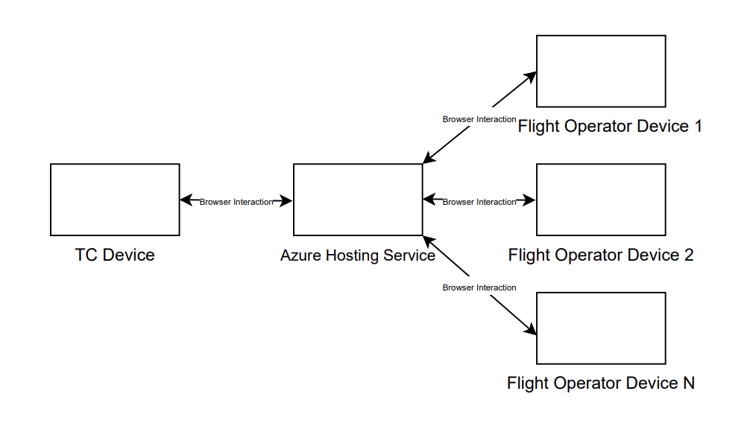
Product Breakdown
System Architecture
Hardware:

Slide 8
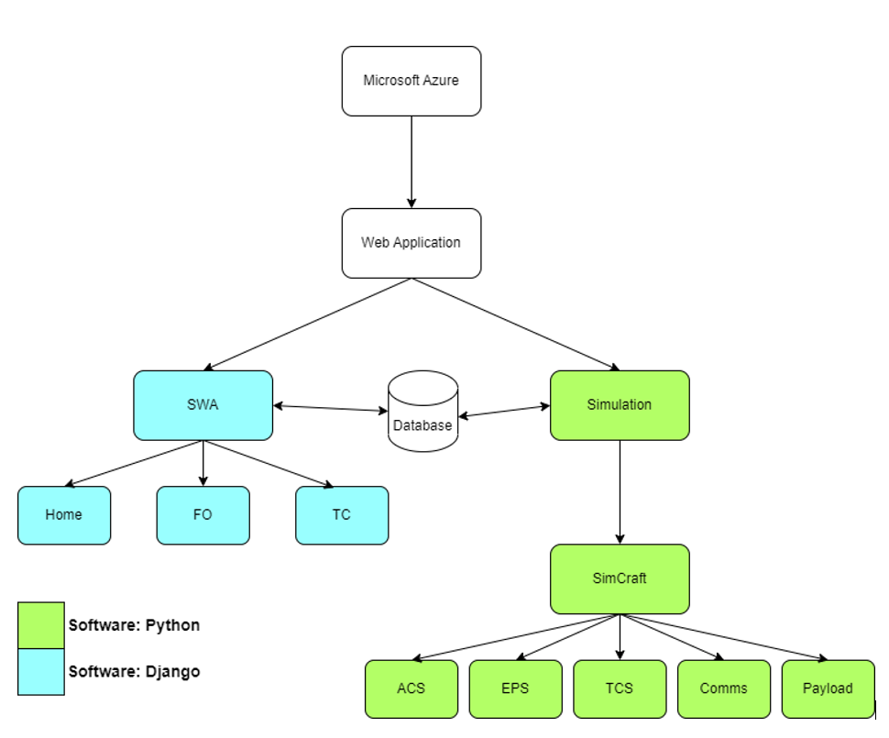
Product Breakdown
System Architecture
Software:

Slide 9
Product Breakdown
Requirements
Front-End:
Must be able to…
Serve users web pages necessary to create accounts and perform tasks specific to their roles.
Test Conductor tasks: create classes, create simulations, assign Flight Operators to simulations, view simulation progress, view completed simulation report.
Flight Operator tasks: create account, join class, view list of assigned simulations, view attributes on assigned simulation , issue commands to assigned subsystem.
Back-End:
Must be able to…
Manage database with user accounts, classes, missions, and simulations.
Define a simulation as a collection of subsystems that behave akin to a satellite in orbit.
Host active simulations as independent threads of execution that are accessible for input of flight operator commands and output of simulation attributes

Slide 10
Product Breakdown
Mission Objective
“A SimCraft is orbiting Earth in LEO. At a certain timestamp, the SimCraft will be overtop ERAU. Students must stabilize and reposition the SimCraft by time it reaches a target longitude to snap a clean photo of ERAU.”
If a SimCraft is stable at target longitude and photo is captured…
Simulation ends
Test Conductor receives report of inputted commands by assigned Flight Operators
If SimCraft is unstable at target longitude and photo is unable to be captured…
Simulation continues, students must wait until SimCraft reaches target longitude to capture image and complete mission
What does this mean?
Mission completion can range from minutes to days!

Slide 11
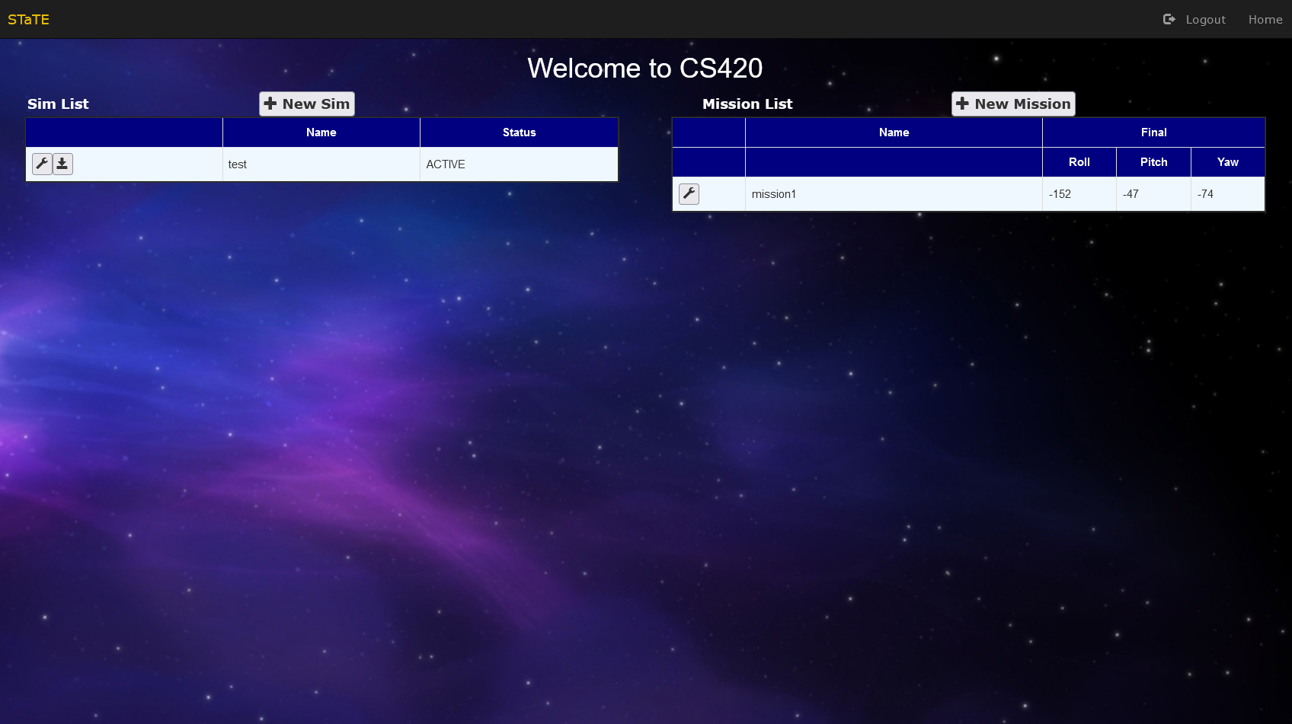
Product Breakdown
Operator Interfaces
Test Conductor
Defines SimCraft final target state
Creates new types of simulation combinations
Assigns roles/subsystems to the Flight Operators
Changes class
Creates a new class
Creates a new simulation
Creates a new mission
Enters login credentials
Views active simulations

Slide 12
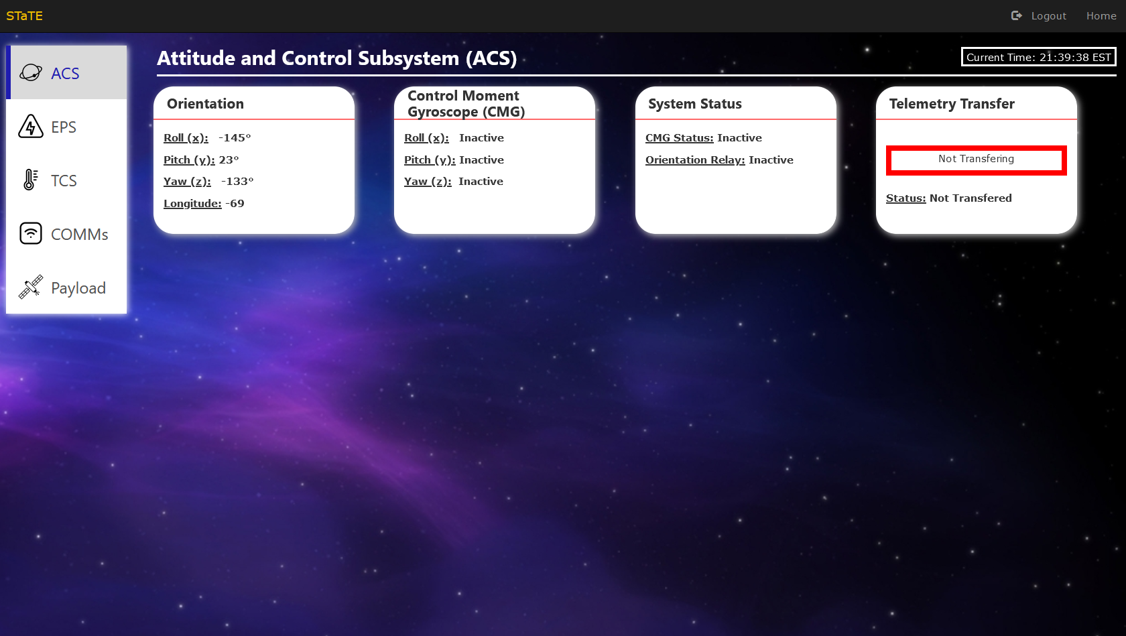
Product Breakdown
Operator Interfaces
Flight Operator (ACS)
Tracks SimCraft orientation
Ensures that Roll/Pitch/Yaw values for SimCraft are valid
Ability to initiate CMGs to adjust Roll/Pitch/Yaw values for SimCraft
Ensures that all subsystem statuses are valid
Ensures proper telemetry transfer to COMMs subsystem
Must ensure that subsystem is stable to be able to complete mission

Slide 13
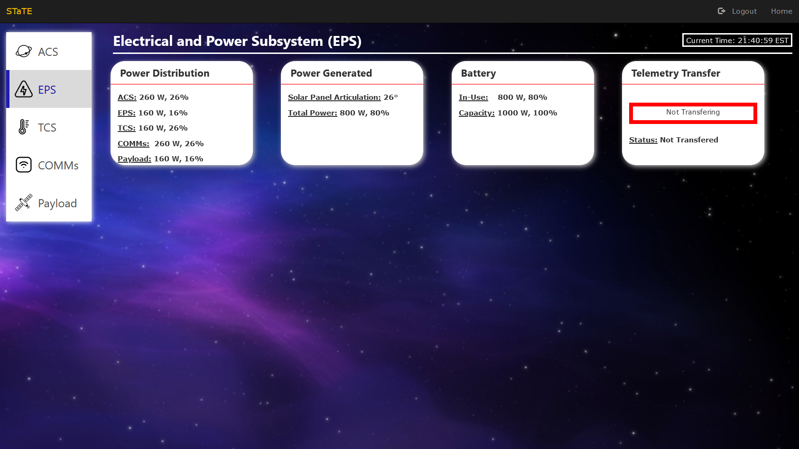
Product Breakdown
Operator Interfaces
Flight Operator (EPS)
Tracks power distribution between subsystems
Stabilizes power distribution between subsystems
Tracks & stabilizes total power and power generated from SimCraft solar panels
Tracks & stabilizes SimCraft battery usage
Ensures proper telemetry transfer to COMMs subsystem
Must ensure that subsystem is stable to be able to complete mission

Slide 14
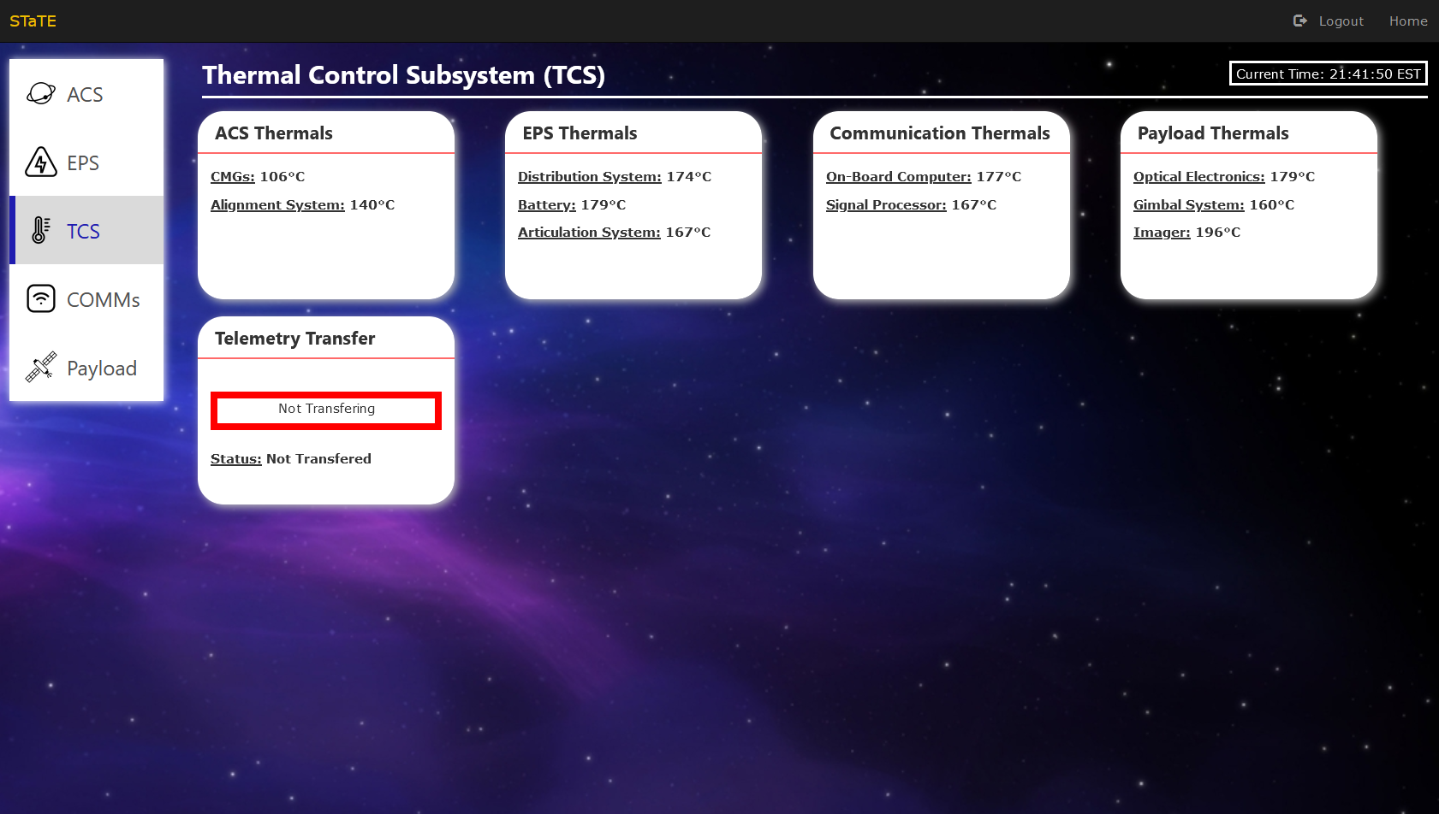
Product Breakdown
Operator Interfaces
Flight Operator (TCS)
Can initiate cooling or heating commands to components of every subsystem
Ensures that all components across the SimCraft remain in thermal range
Ensures proper telemetry transfer to COMMs subsystem
Must ensure that subsystem is stable to be able to complete mission

Slide 15
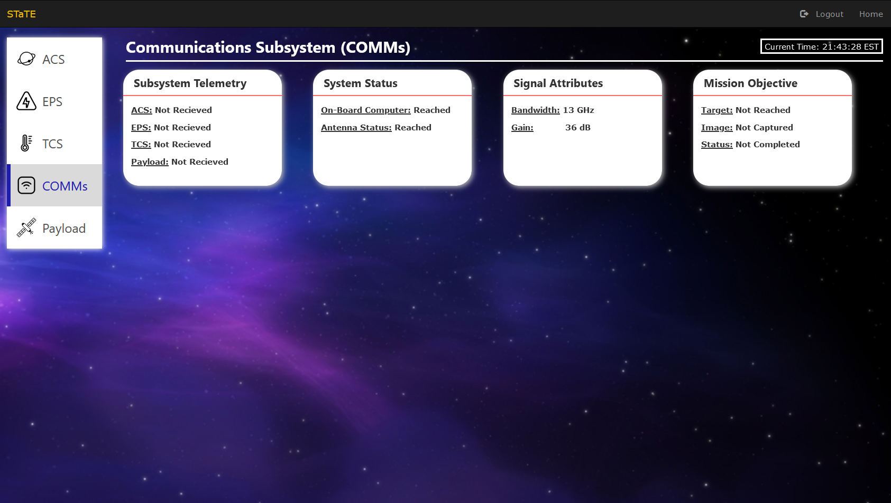
Product Breakdown
Operator Interfaces
Flight Operator (COMMs)
Tracks if telemetry from other subsystems has been received
Ensures signal statuses are reached
Ensures valid antenna signal by having the ability to adjust the antenna gain
Able to track mission objective
Must ensure that subsystem is stable to be able to complete mission

Slide 16
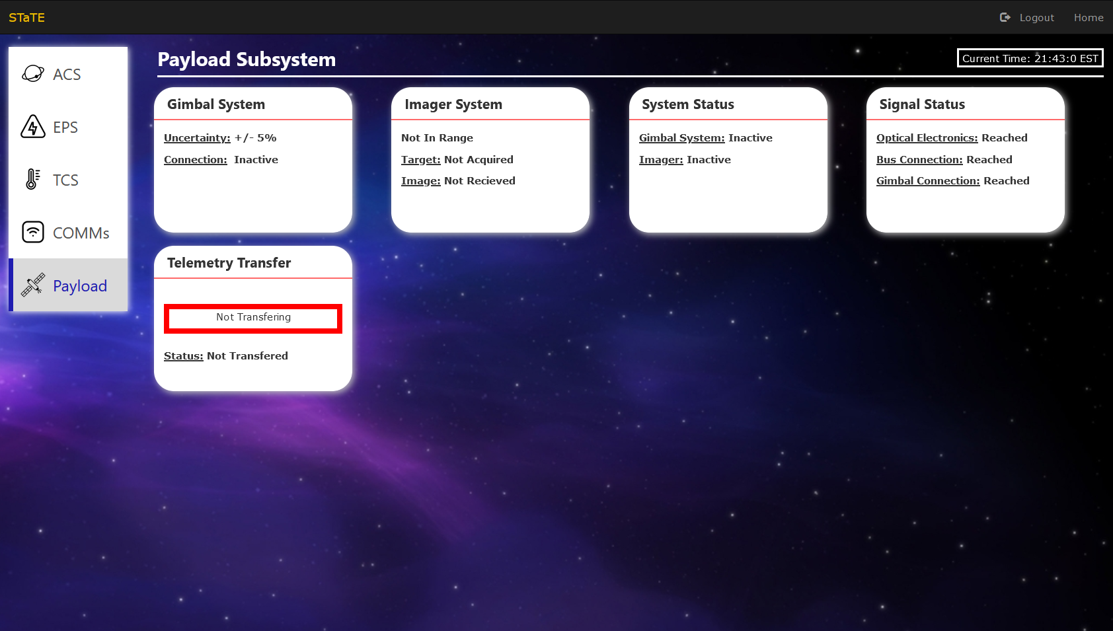
Product Breakdown
Operator Interfaces
Flight Operator (Payload)
Tracks & stabilizes gimbal system
Tracks & stabilizes imager system
Ensures subsystem statuses remain valid
Ensures proper telemetry transfer to COMMs subsystem
Must ensure that subsystem is stable to be able to complete mission

Slide 17
VIDEO DEMOS ARE COMING VERY SOON, WILL BE HERE ON 4/21/2023, CURRENTLY IN THE PROCESS OF EDITING/SPLITTING UP THE VIDEO
DELETE ME
WHEN VIDEO
DEMOS ARE IN

Slide 18
Product Breakdown - Demo
Creating a Class recording (video demo)

Slide 19
Product Breakdown - Demo
Creating a mission (video demo)

Slide 20
Product Breakdown - Demo
Registering a student (video demo)

Slide 21
Product Breakdown - Demo
Student joining a class (video demo)

Slide 22
Product Breakdown - Demo
Creating a simulation (video demo)

Slide 23
Product Breakdown - Demo
Student interacting with Sim (video demo)

Slide 24
Product Breakdown - Demo
The whole process from creating a class, all the way to a student messing with the sim (video demo)

Slide 25
03
Challenges & constraints

Slide 26
Challenges & Constraints
Database Complications
Challenge: Number of read/write operations quickly overloads SQLite database.
Solution: SimCraft are managed in threads to combat excessive database access.
Subsystem Synchronization
Challenge: SimCraft subsystems operate concurrently and must share some data.
Solution: Shared data is maintained by SimCraft and accessed by subsystems as needed.
Version Control
Challenge: Large team working concurrently on project files
Solution: Assignment of team members to specific areas/features to avoid conflicts and double-work

Slide 27
04
Conclusion

Slide 28
Conclusion
Project Summary
Goals:
Create a simulated Spacecraft Mission Environment to be updated real-time
Create interactive user interfaces
Be able to assign students to different role(s)
Access simulation cross-platforms
Generate post-mission reports
Accomplishments:
Did we meet all of the goals listed on the side?
Did we accomplish something that wasn’t originally in our goal list?

Slide 29
Questions?

